Slide 1
8/3/17
EternaBrain – Rohan Koodli

Slide 2
Trying
Prepping more data (12K puzzles)
hoglahoo
20 experts
Testing entire algorithm on Eterna100
Improving reward function for reinforcement learning
Fixing bugs

Slide 3
Methods
92 puzzles, 30K moves, 70 experts (solved over 3000 puzzles each)
Convolutional neural net, 10 convolutional layers (with pooling), 3 fully-connected, 150 epochs, 0.9 keep prob
2D convolutions (height 7 to match number of features, 7 nearest neighbors)
But essentially 1D convolutions with 7 nearest neighbors
https://github.com/eternagame/EternaBrain/blob/master/rna-prediction/baseCNN.py
https://github.com/eternagame/EternaBrain/blob/master/rna-prediction/locationCNN.py

Slide 4
Methods
Realized that with added pairmaps, features are no longer 7 by 7, but rather 8 by 8 (location) and 9 by 9 (base)
Retrained using new convolution size
92 puzzles, 30K moves, 70 experts (solved over 3000 puzzles each)
Convolutional neural net, 10 convolutional layers (with pooling), 3 fully-connected, 150 epochs, 0.9 keep prob
2D convolutions (height 8/9 to match number of features, 8/9 nearest neighbors)
But essentially 1D convolutions with 8/9 nearest neighbors

Slide 5
Methods
Added “post-processor” which goes through each individual base and mutates it to A, U, G, or C and sees which brings it closer to target structure, corrects base pairings, and other minor fixes
https://github.com/eternagame/EternaBrain/blob/master/rna-prediction/predict_pm.py
https://github.com/eternagame/EternaBrain/blob/master/rna-prediction/fix.py
https://github.com/eternagame/EternaBrain/blob/master/rna-prediction/dsp.py

Slide 6
7 x 7 convolution
baseCNN
Train Accuracy: 0.65
Test Accuracy: 0.48
locationCNN
Train Accuracy: 0.29
Test Accuracy: 0.29

Slide 7
New 8/9 x 8/9 convolution
baseCNN
Train Accuracy: 0.75
Test Accuracy: 0.51
locationCNN
Train Accuracy: 0.31
Test Accuracy: 0.34

Slide 8
Results
Solved 58/80 of Eterna100
RNA-SSD: 27/100
RNAinverse: 28/100
DSS-Opt: 47/100
NUPACK: 48/100
INFO-RNA: 50/100
MODENA: 54/100
EternaBrain: 58/60

Slide 9
Eterna100
✔️ = Solved
✖️ = Couldn’t solve
= Haven’t tested

Slide 10
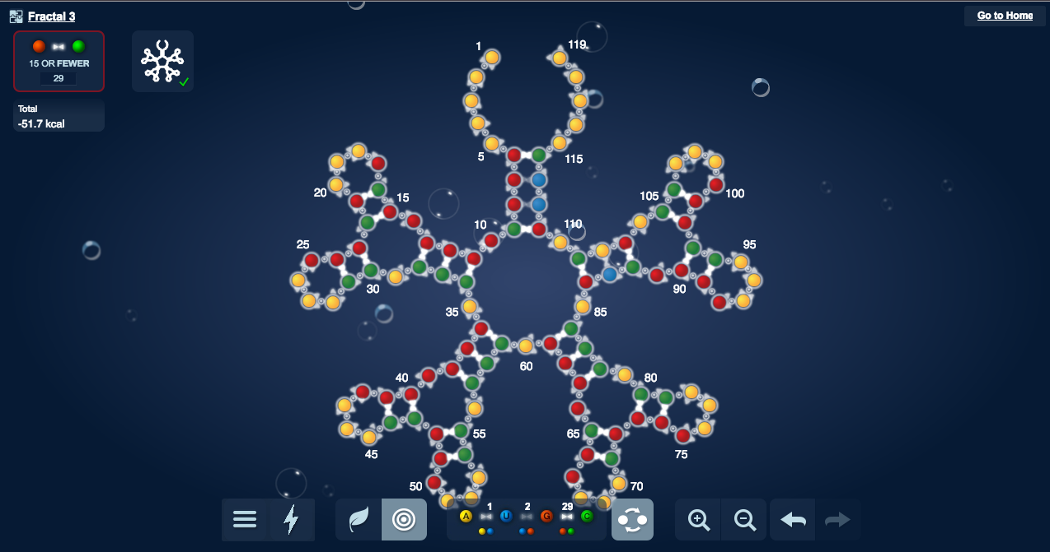
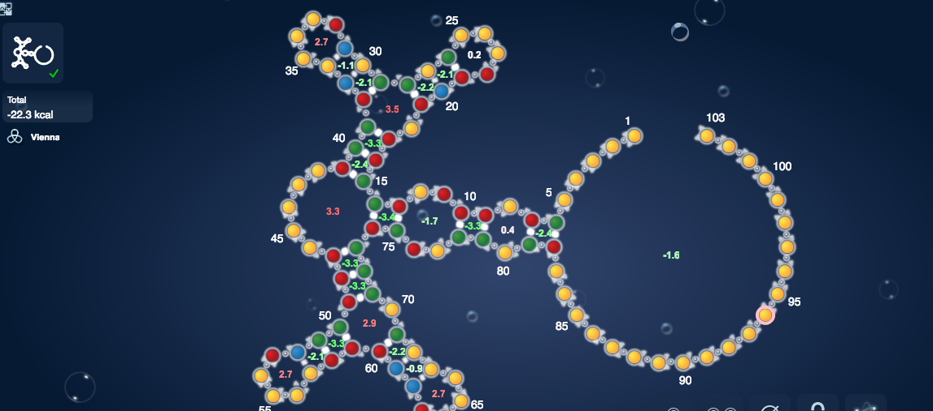
Results
Fractal 3
Water Strider

Slide 11
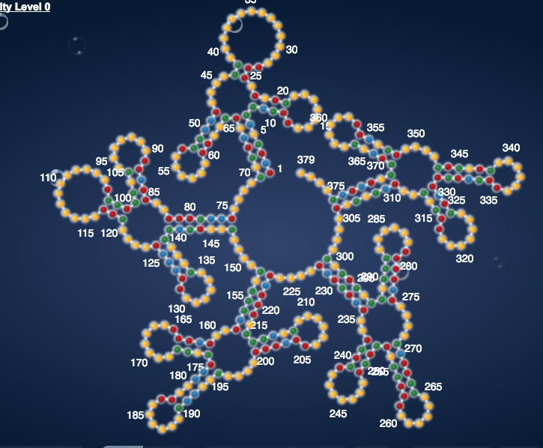
Results
Saccharomyces Cerevisiae

Slide 12
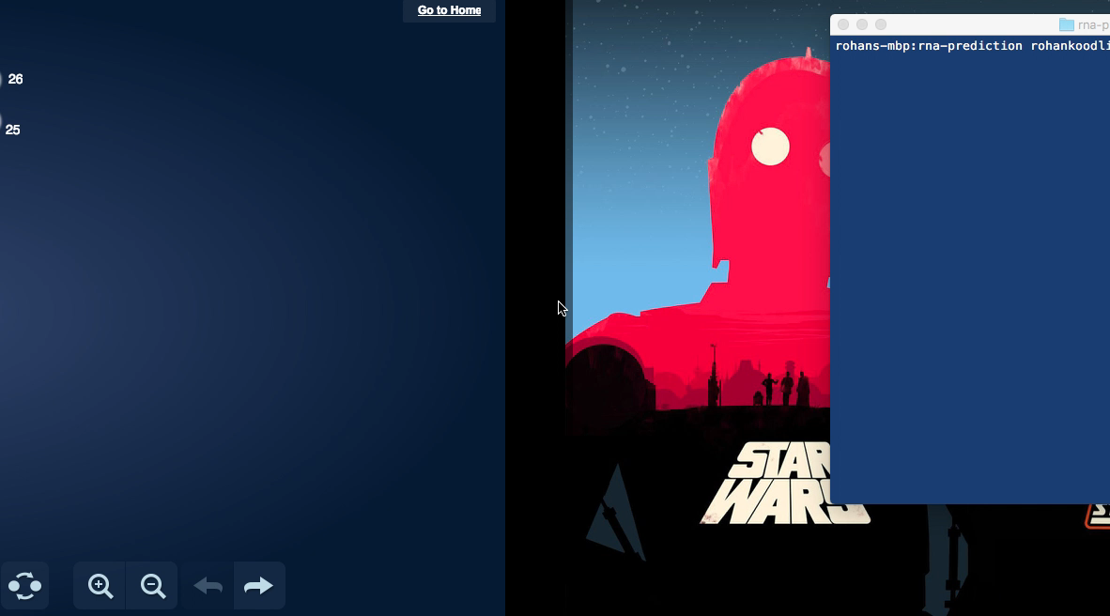
Results

Slide 13
Conclusions
Last week’s test accuracy appears to be a fluke
Exact same parameters, but test accuracy for both location and base are ~0.15 higher
Expanding the convolution size also seemed to help
So far it has solved 58/80, the remaining 20 are all the more difficult ones, I suspect the total out of 100 it will solve will be ~59

Slide 14
Next Steps
Train with more specific data
hoglahoo
20 experts
Vary hyperparameters
Convolution size, dropout, epochs
Fix bugs in playouts
Make the reinforcement learning better

